Slide 1

AutoCAD Eagle PCB Design Workshop
David House, David Story, Joseph Haun, Adam Ortega

Slide 2
Introduction
This lab will get you familiar with board design tools in AutoCAD Eagle
You should have AutoCAD Eagle Community or Student downloaded
You will be provided with an Eagle Schematic (workshop.sch)
Your goal is to create a printed circuit board (PCB) from the provided schematic

Slide 3
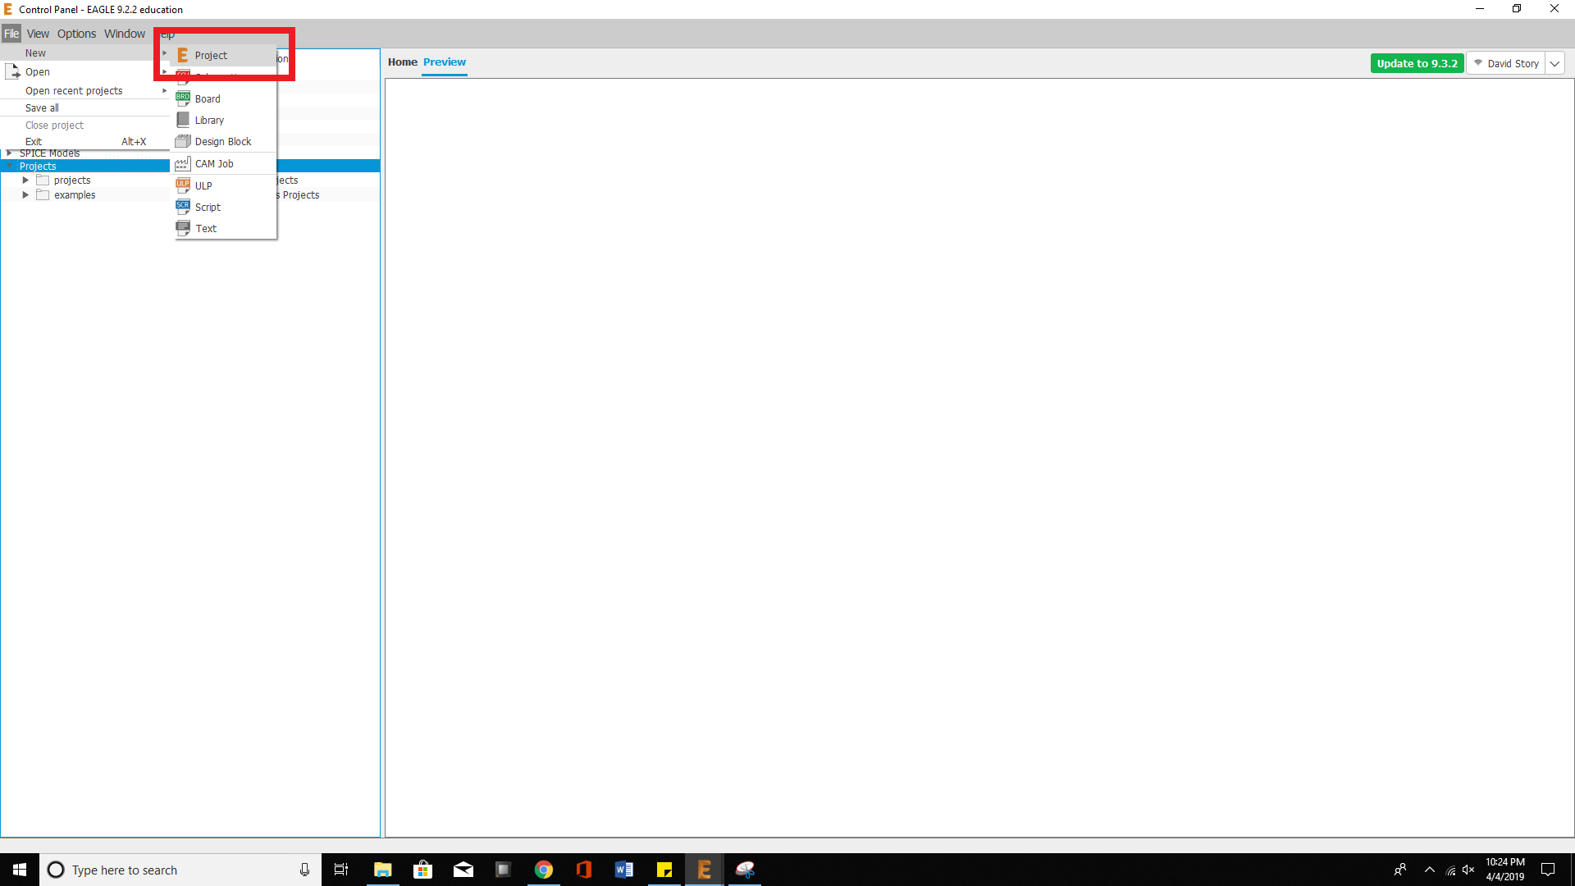
Creating a New Eagle Project

Slide 4
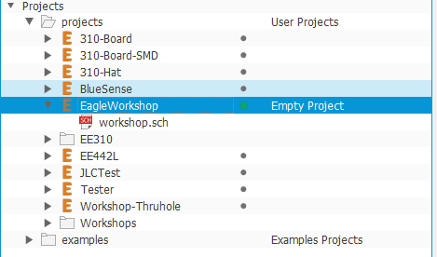
Creating a New Eagle Project
After you have created the new Eagle Project, it should appear under the ‘projects folder’
Next, find where you downloaded the file ‘workshop.sch’ and then drag and drop it onto your new project (e.g. drag and drop ‘workshop.sch’ onto ‘EagleWorkshop’

Slide 5
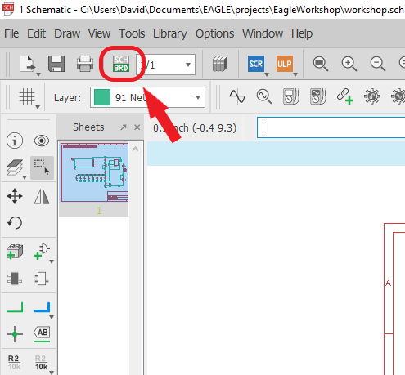
Creating a board file from the schematic
Press the schematic file to open it
Observe the schematic and analyze how it works
When you are ready, press the “sch/brd” button and press “yes” on the pop-up to create a new board.
This board file will be linked to your schematic file. All the parts and connections in your schematic will be mirrored in the board file

Slide 6
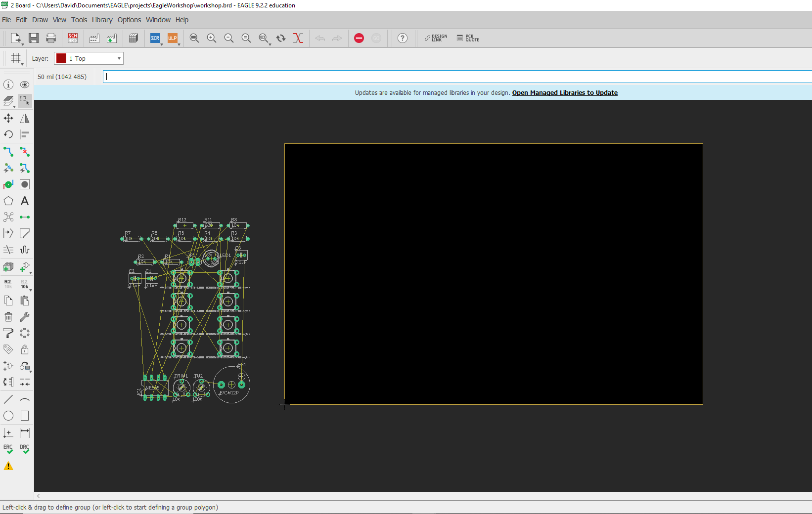
Board File
Your new board file will look like this
The parts are show on the left. The solid black box on the left is the PCB. The yellow outline of the black box defines its dimension
We will now learn about this page, some tools on the sidebar, and then learn how to change the boards dimensions.

Slide 7
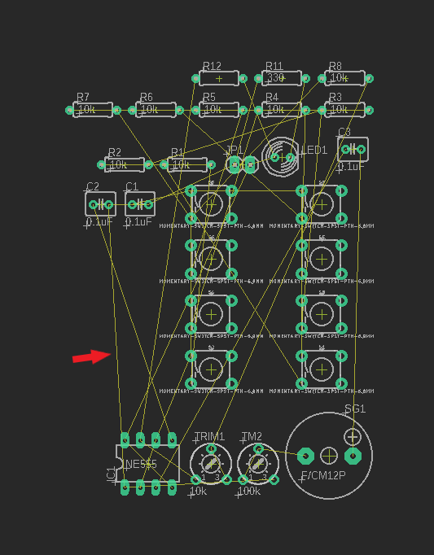
The Rat’s Nest
The yellow lines, like the one the arrow is pointing to, is called a “rat’s nest”
The rat’s nest shows where the trace (the copper lines) have to go to properly connect the pads or pins of your parts.
When you wire together parts in the schematic, the rat’s nest reflects these changes.
The rat’s nest is not a valid connection yet, it is only an outline of where you need to route, in the next few slides we will learn how to physically connect or ‘route’ the parts with copper lines.

Slide 8

The Toolbar
1.
9.
We will now describe some useful tools on the toolbar. For more in-depth information go to: https://www.autodesk.com/products/eagle/blog/schematic-basics-part-1/
2.
10.
3.
11.
Info – Display part information
Layer settings – shows different copper and silkscreen layers
Move tool – use to move parts, traces, dimensions, etc
Rotate – use to rotate parts, silkscreen, text, etc
Trace – this tool lets you route parts that are connected via rat’s nest
Via – this create a hole with copper connection to switch to different electrical layers
Polygon – lets you create shapes in copper or other defined settings
Rat’s nest – this will re-render the rat’s nest after you move or trace parts
View – this will highlight traces and parts you select
Group – this allows you to select multiple parts, traces, silkscreen, etc.
Mirror – allows you to mirror a part, silkscreen, etc
Rip-up – this button is what you use to delete trace
Text – allows you to add text to board
4.
5.
12.
6.
7.
13.
8.

Slide 9
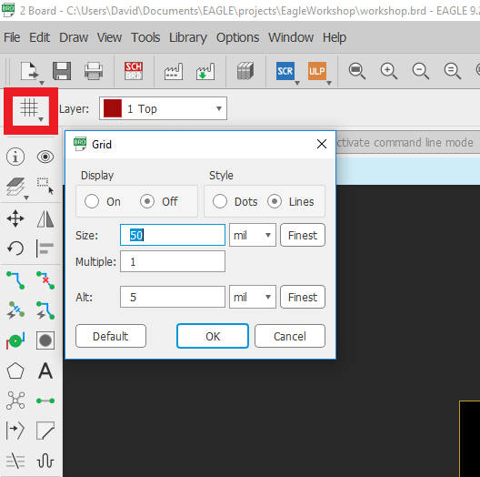
Grid
Grid allows you to set the dimensions type for the grid and for part placement
Can be in inches, mil (1/1000 of an inch) or millimeters.
Display lets you display dots or line that represent your grid size. Good for visualizing sizing of parts and trace lengths.

Slide 10
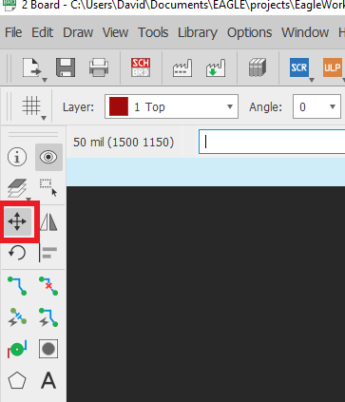
Moving parts
We will now begin by selecting the move tool
We want to use the move tool for two reason right now:
We can use it to manipulate the board dimensions
We can use it to place the parts on the board

Slide 11
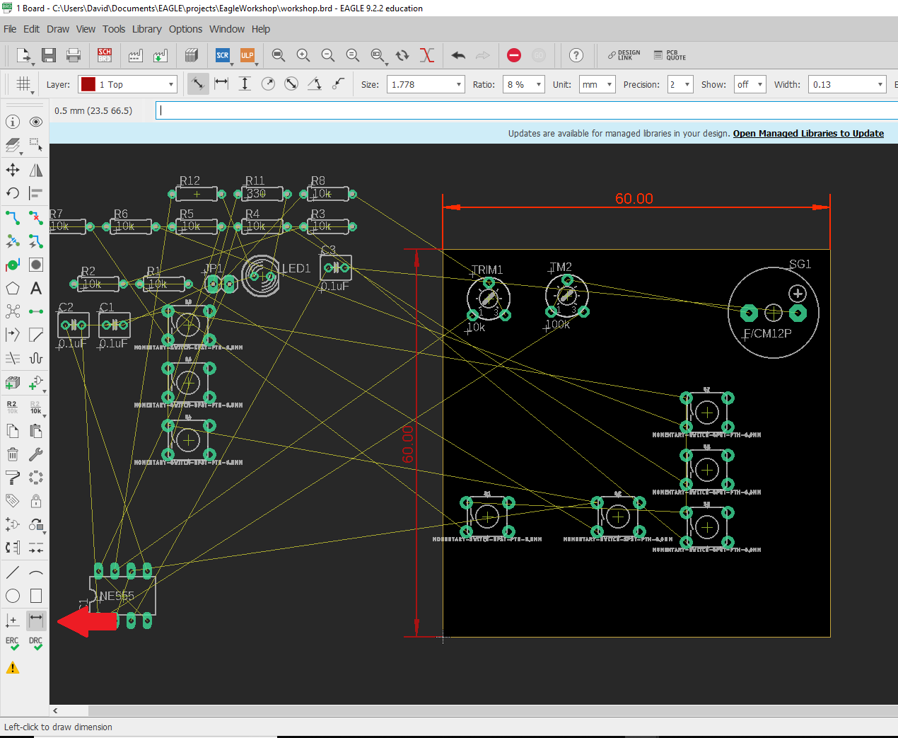
Changing the board dimensions
The arrow points to the dimension tool. Press this button and then press a side on the board to see it’s dimensions
Re-select to the move tool, then grab the edges of the board. Try to make the board around 50 x 50 mm or 60 x 60 mm
Once you have set the board dimensions, try moving parts around.
Select the group tool, press and drag the mouse and try to select some parts. After you selected some parts, select the move tool again. Right click anywhere on the screen. You should see something that says “group”, press that. You can now move groups of parts.

Slide 12
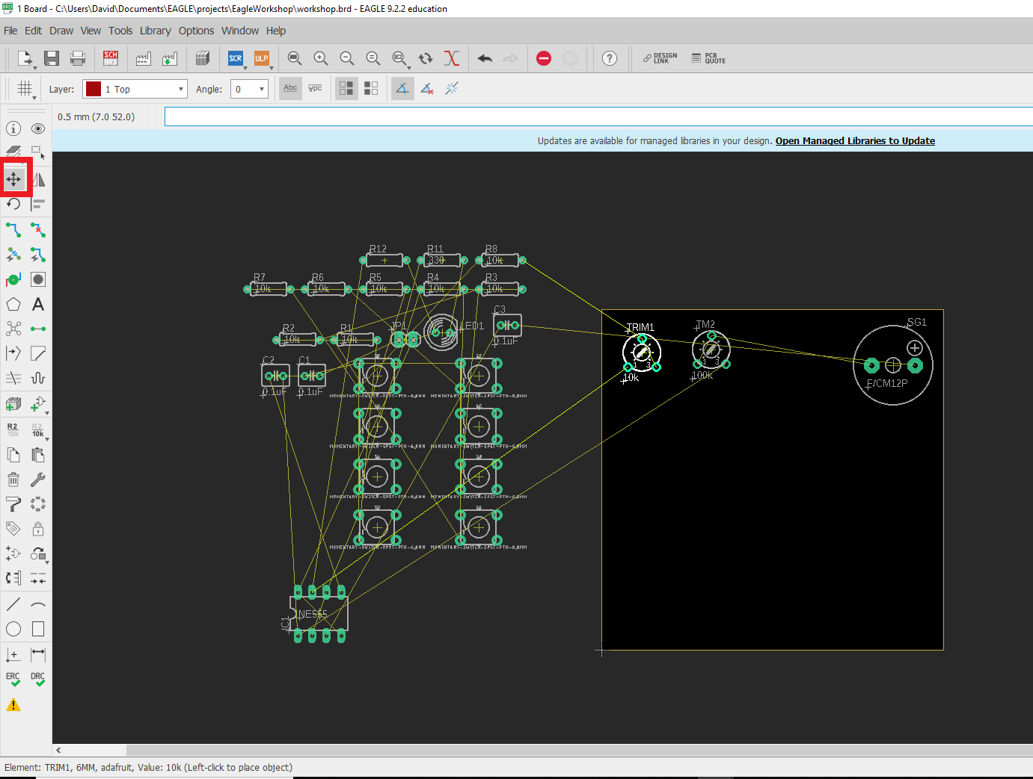
Moving parts onto the board
Now that the dimensions are set and you know how to move parts, move all the parts onto the board area.
Position the parts so that they do not overlap. Think about how you will solder these parts, make sure to leave room so you can easily solder parts.
Make sure pads are fully on the board
Parts that are connected together should be positioned so their pads are close, this will make routing the copper easier.

Slide 13
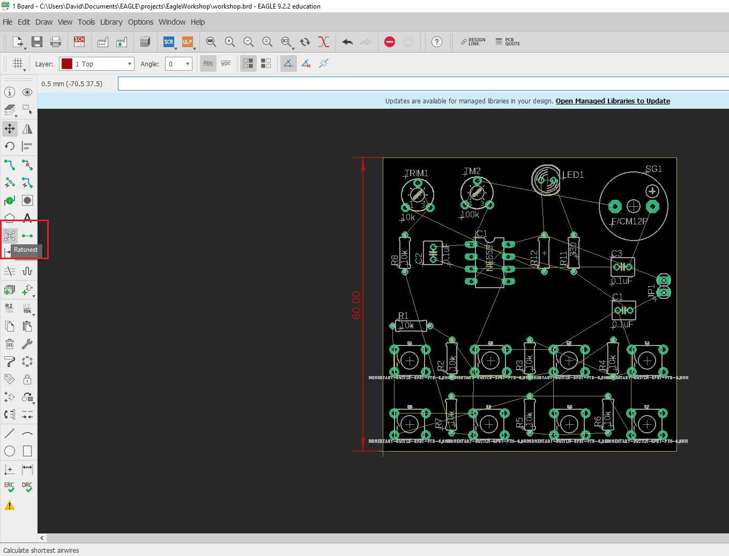
Preparing to route
Once you have placed the parts on the board, press the “Ratsnest” button to re-render the rat’s nest connections
Take another moment to look over the board for any missed connections, any overlapping pads.
White text, also called silkscreen, can overlap, as it is not an electrical connection.
Take a quick break to prepare yourself to route your first printed circuit board.

Slide 14
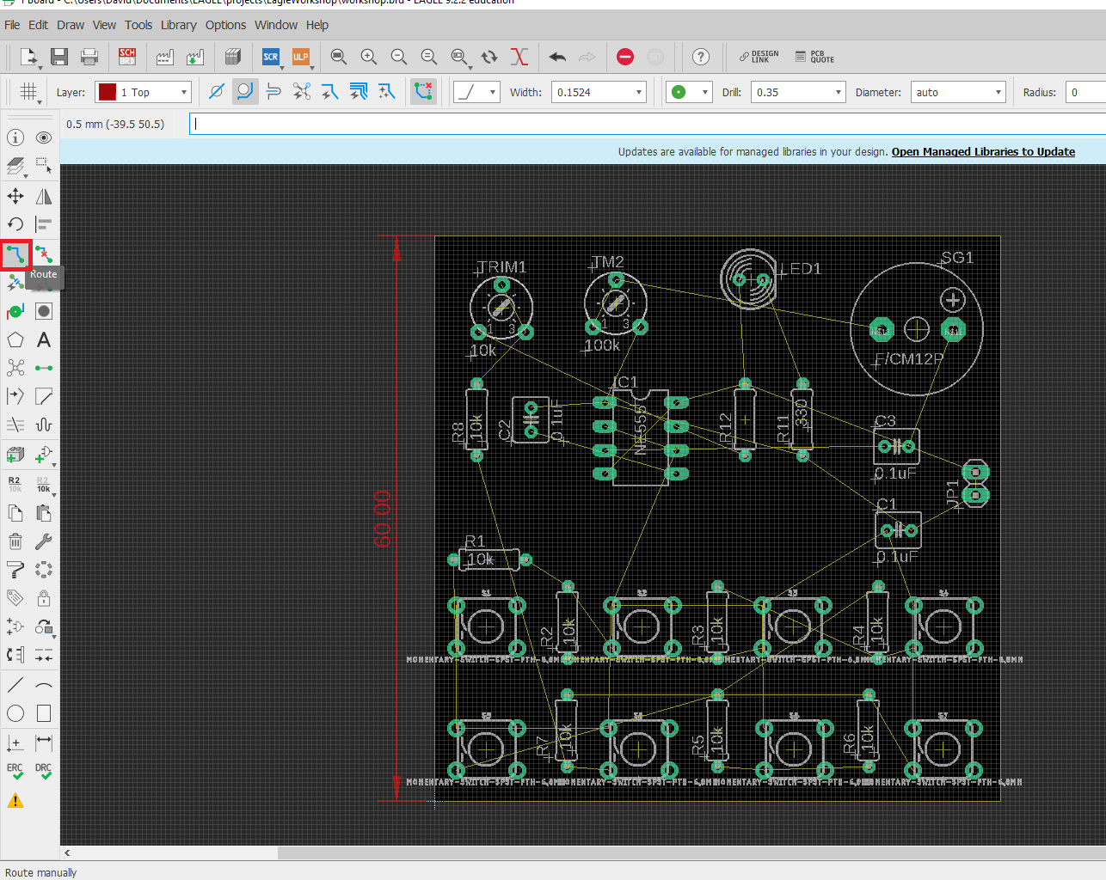
Routing the board
Press the ‘route’ button to select the routing tool
You can now press any pad / pin / rat’s nest and begin routing the lines.
This is a two layer board so you can route trace on the Top and Bottom of the board.
We will cover how to switch connections between layers in the next slides. Practice routing on the top layer for now.

Slide 15
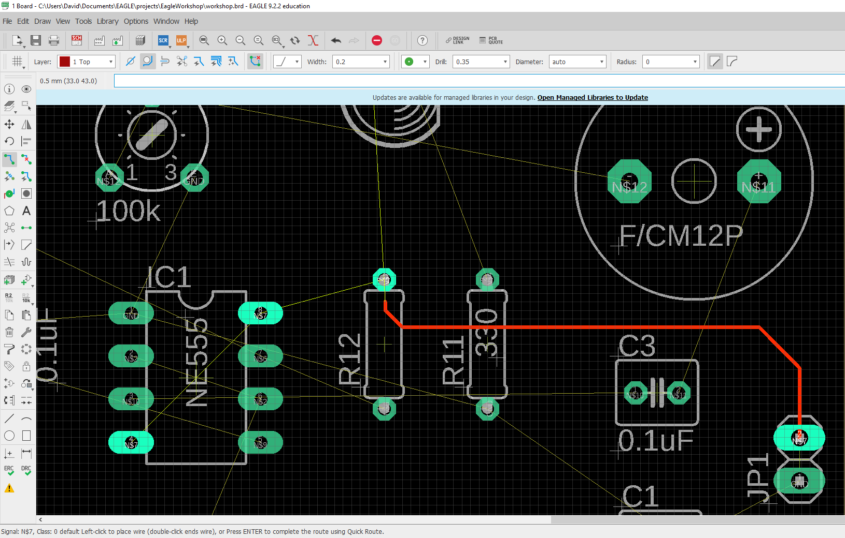
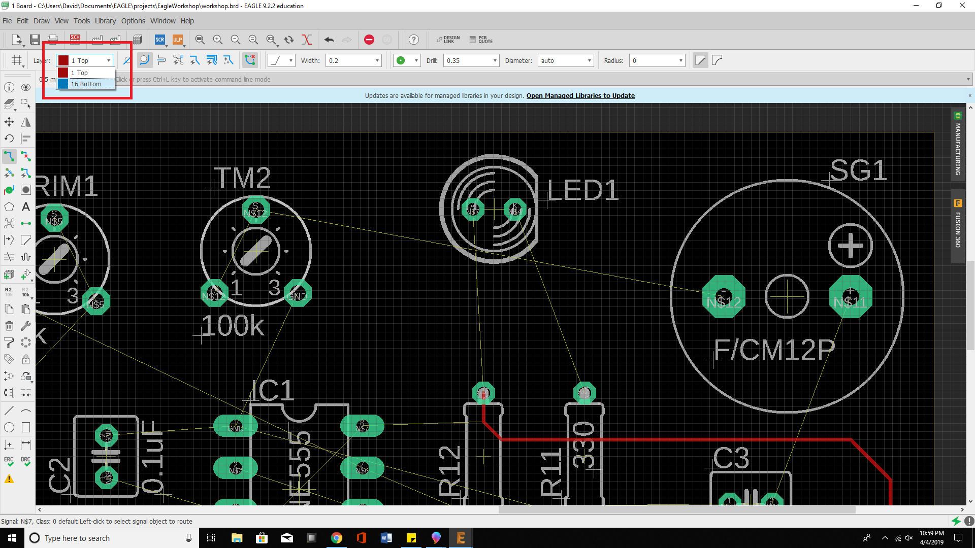
Routing the board
When routing, ensure that you actually connect to the pad or pin you are trying to route to.
Once you successfully route to the pad or pin, the trace will not be ‘bright’, meaning it is connected.
You can test the connection by using the move tool to move the trace to see if it is unconnected.

Slide 16
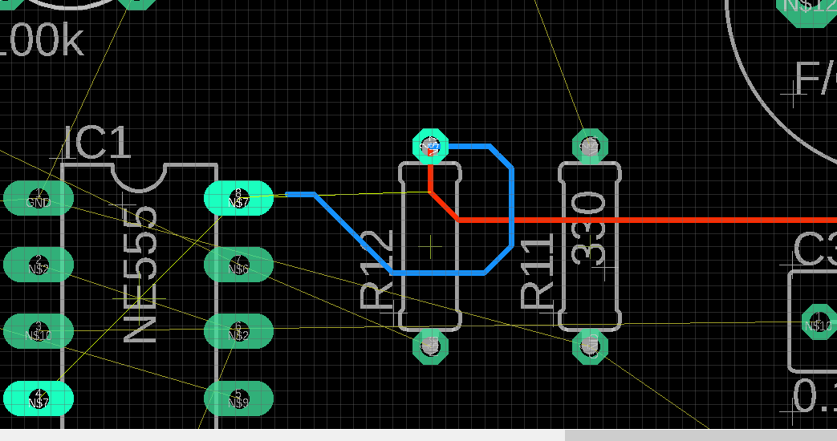
Routing on other layers
Press the drop down menu in the upper left corner, from here select layer 16: Bottom
You are now working on the Bottom layer. Try tracing a pad, you will probably see a blue line. This means the trace is on the bottom of the board.
Try routing over a red line, since the red line is on the top of the board, its ok to cross over the line since you will not be interfering with it.
In the next slide, we will discuss how you can make top layer lines connect down to the bottom layer.

Slide 17
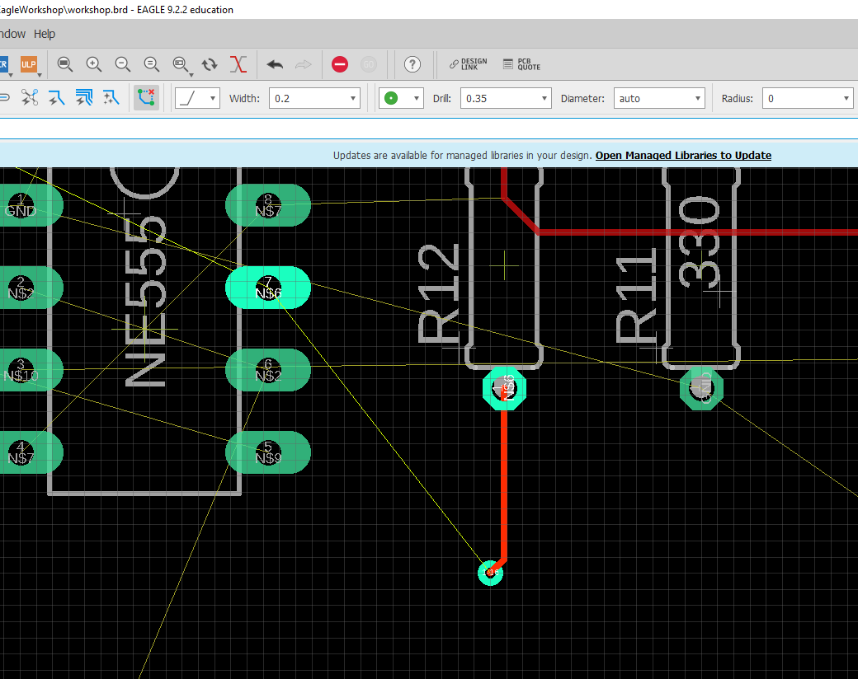
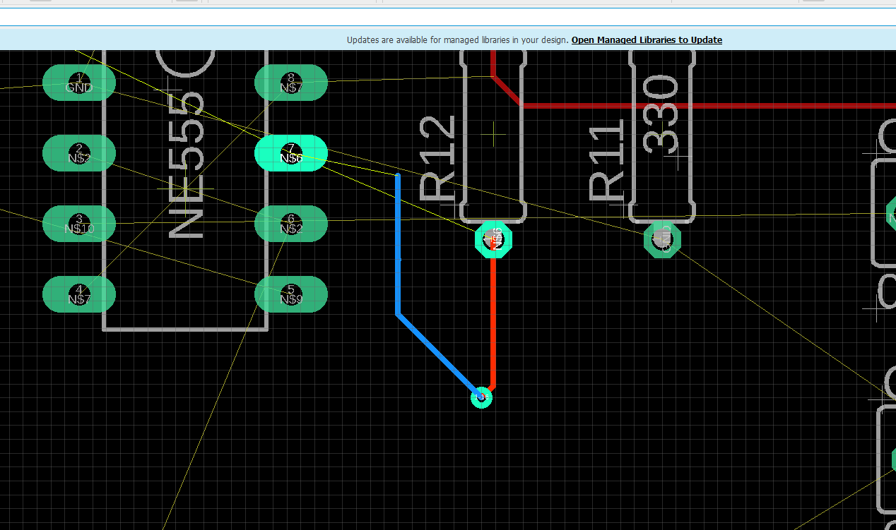
Vias: the portal to the other layers
A via allows you to start tracing on other layers of the board (e.g. you have a top layer trace, and want that same connection to go to bottom layer since a top layer trace is blocking your path)
When routing a line, hit the middle mouse button, a via should appear. Left click to place it. Now you should be routing on the other layer.
Ask the lab assistance for assistance if needed.

Slide 18
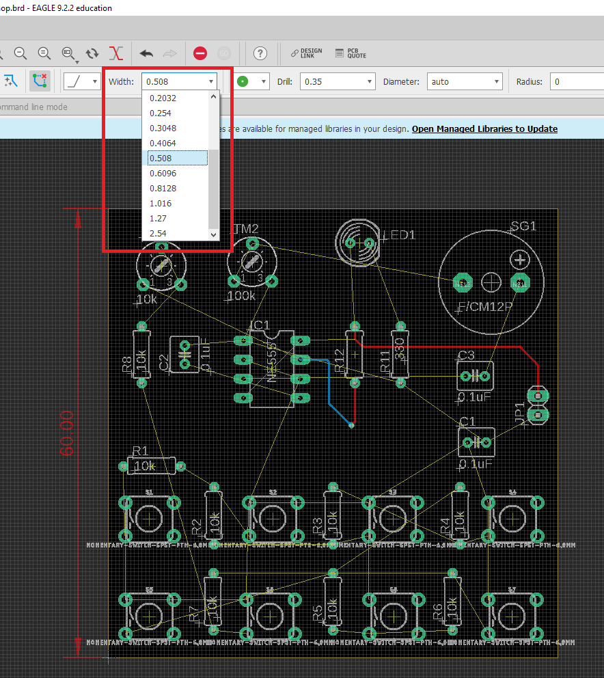
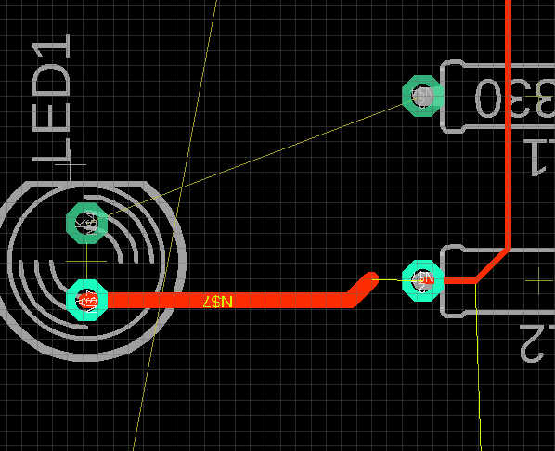
Changing trace width
This is an optional section: you can practice changing the trace width to different sizes.
This allows you to make lines that can carry larger currents or that need to be impedance matched.
For this board, we can use the default trace width, but you can try changing the width for fun.

Slide 19
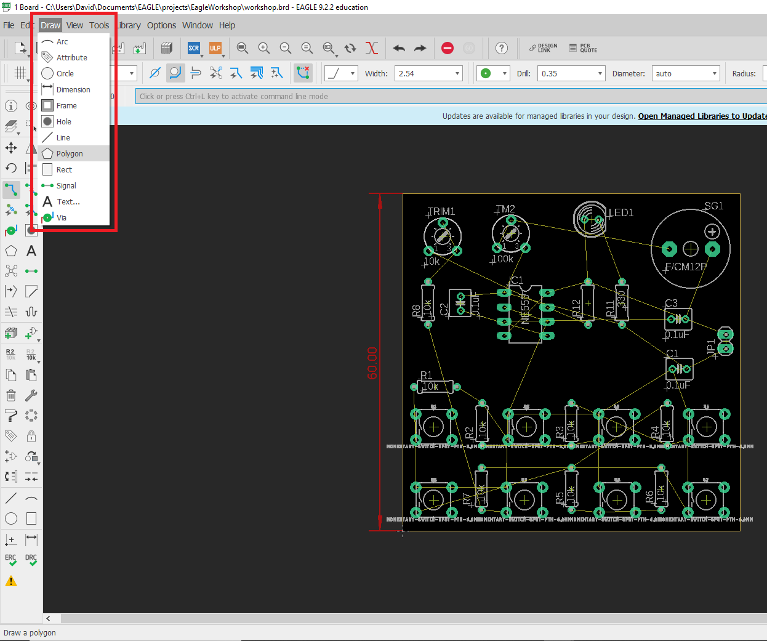
Polygon
Polygons can be used to make planes: large copper sections that can have ground, power, or other signals that have a lot of connections on your board
This lets you simply use a via or connection to connect to that plane.
Polygon lets you trace any type of shape and define what it’s signal it will carry.
Select it from the draw drop down or from the toolbar

Slide 20
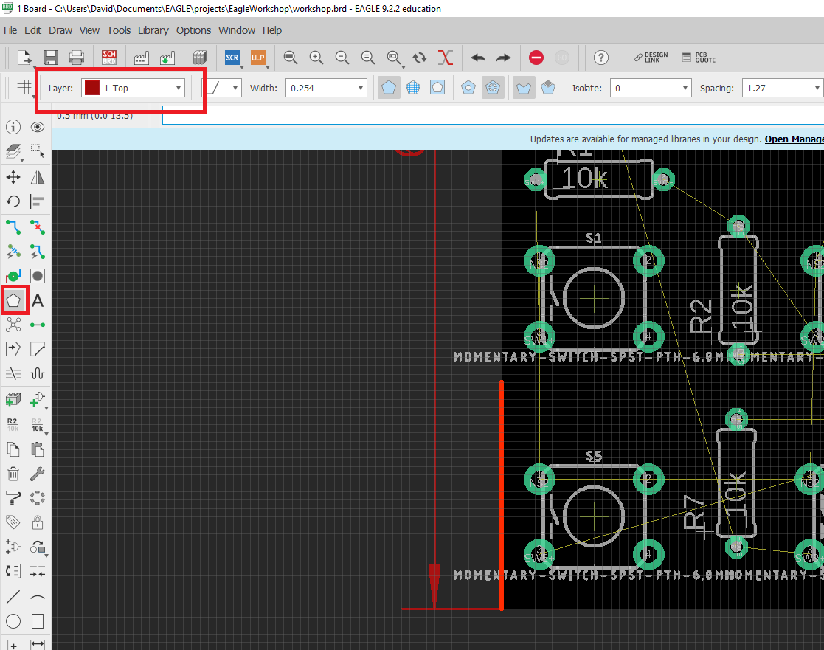
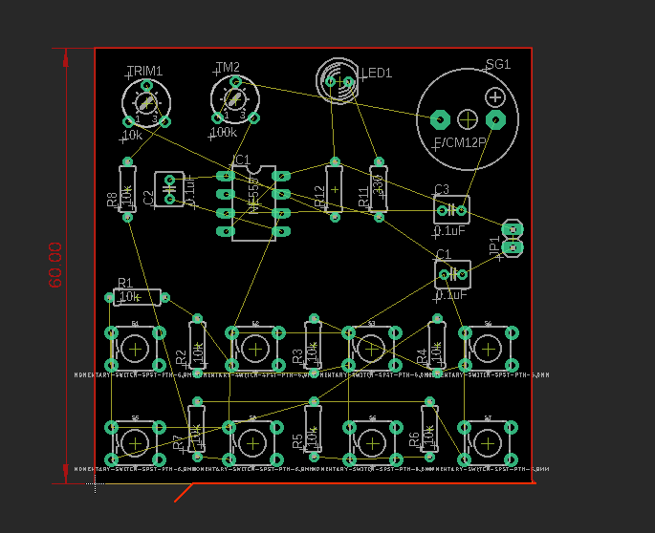
Polygon: ground plane
In this case, we will use the polygon to make a ground plane
With the top layer selected, press the polygon tool. Trace the outline of the board. At every junction (when you need to turn) press the left mouse button to set the polygon’s points.
Once you reach the end of your polygon, make sure to press the original point to fully connect. Like when you are routing, the polygon line should go from bright to dull to indicate it is connected.
In the next section we will connect the polygon to the ground signal.

Slide 21
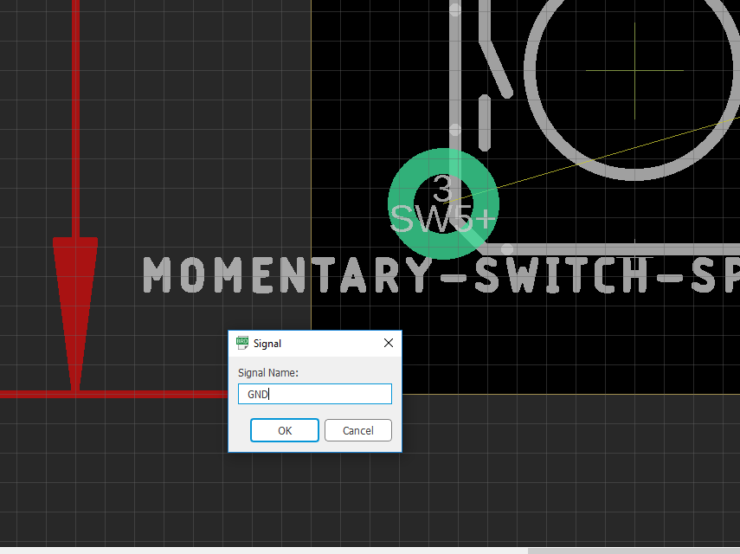
Polygon: ground plane
Once you connect the polygon, this signal box will show up
Type the name (the identifier) of the signal you want to connect to the polygon, in this case it would be ‘GND’
After you type this and press ok, press the rat’s nest botton on the toolbar, you should see the plane appear on the board.

Slide 22
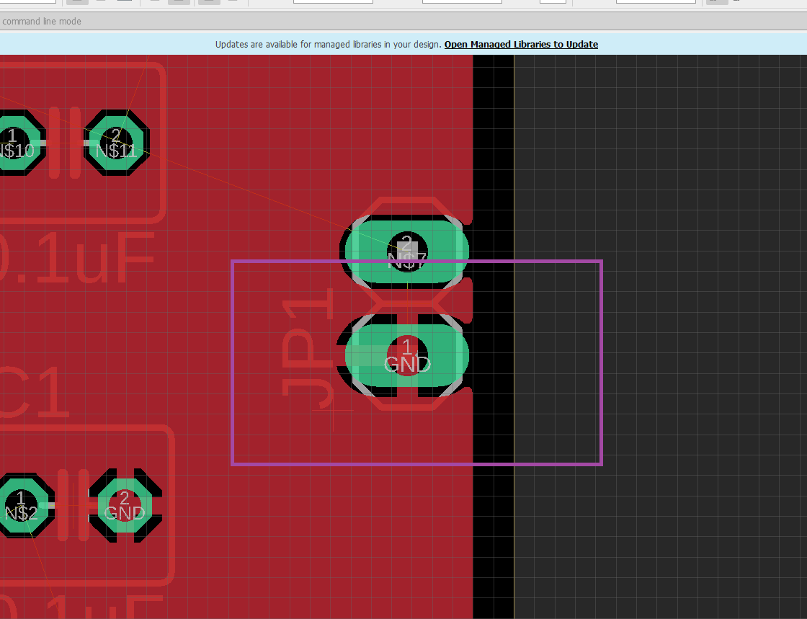
Polygon: ground plane
Find a ground connection after you make the polygon and assign it to ‘GND’
You should see that all the ‘GND’ signals are now connected to the ground plane.
Typically, you want to route the other signals on the board first, then create the planes, then check that all the plane signals are routed.

Slide 23
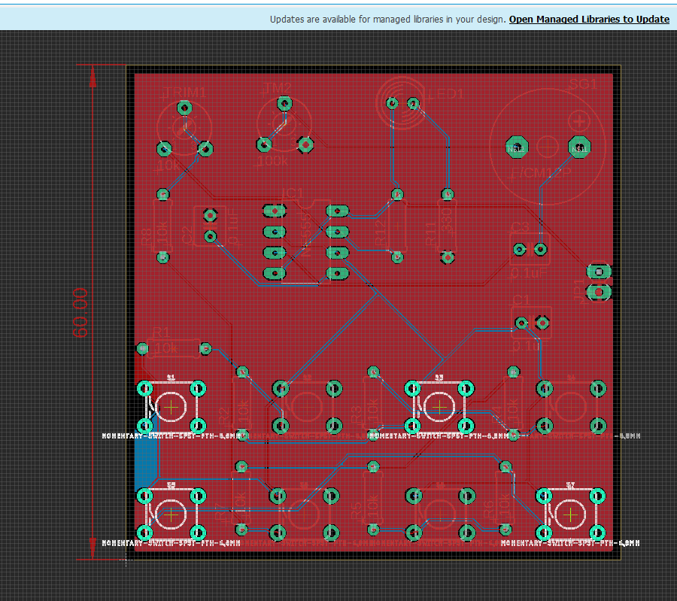
Go ahead and finish routing
Make sure you have all rat’s nest wires gone and that all pads / pins are properly connected
Make sure vias don’t overlap on unwanted trace
Make sure you have fun! Routing is part engineering part art. Try to make your traces without a lot of jitter or sharp turns.

